Slide 1

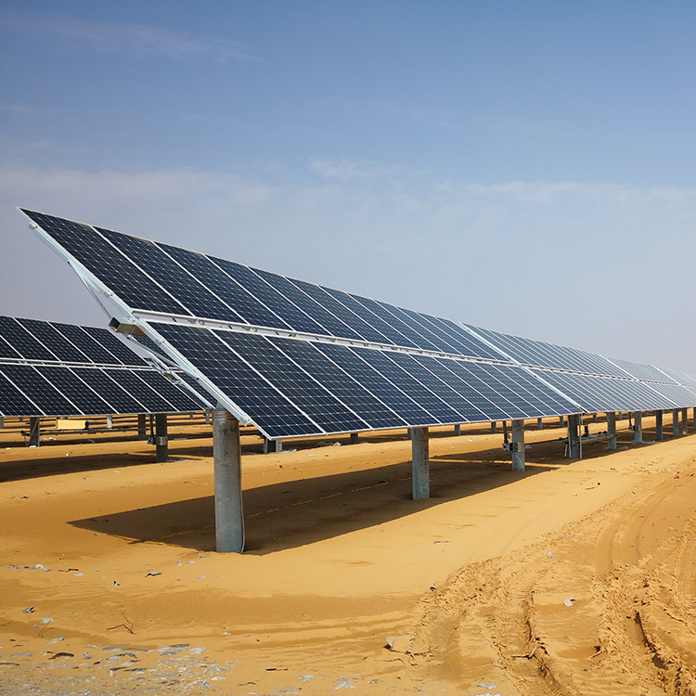
Dual Axis Solar Tracking System
GROUP 10
Suggestions Given during Meeting :
1. Include Power Calculation

Slide 2
Importance of Solar Energy and the Need for Solar Tracking
Energy Waste Without Solar Tracking
Did you know that without solar tracking, the energy efficiency of solar panels is only 70%? This means that 30% of the energy is wasted due to lack of suboptimal angle adjustments.

Slide 3

Basic Mechanism of Dual Axis Solar Tracking System
1
Sensor Input
LDR sensors detect solar irradiance and send input to the microcontroller.
2
Processing in Microcontroller
The STM 32 microcontroller processes the sensor data for determining the solar panel positioning.
3
Actuator Output
The microcontroller then provides output to the servomotors for adjusting panel angles.

Slide 4
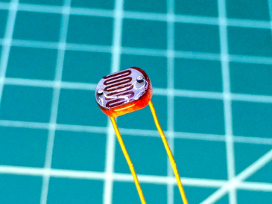
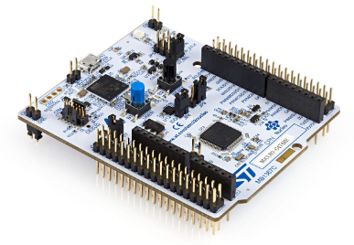
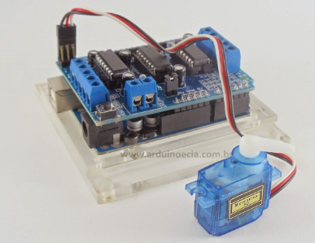
Components Used
LDR Sensors
STM 32 Microcontroller
Servomotors and LCD Screen
These sensors detect solar irradiance for accurate position tracking.
This high-performance microcontroller processes sensor data for precise adjustments.
Servomotors act as actuators for panel movement while the LCD screen displays the current position.

Slide 5
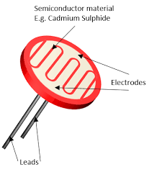
lDR Sensor
An LDR (Light Dependent Resistor), also known as a photoresistor, is a passive electronic component that varies its resistance based on the intensity of light it is exposed to.
The resistance of an LDR decreases as the intensity of light falling on it increases. Conversely, when the light intensity decreases, the resistance of the LDR increases.

Slide 6
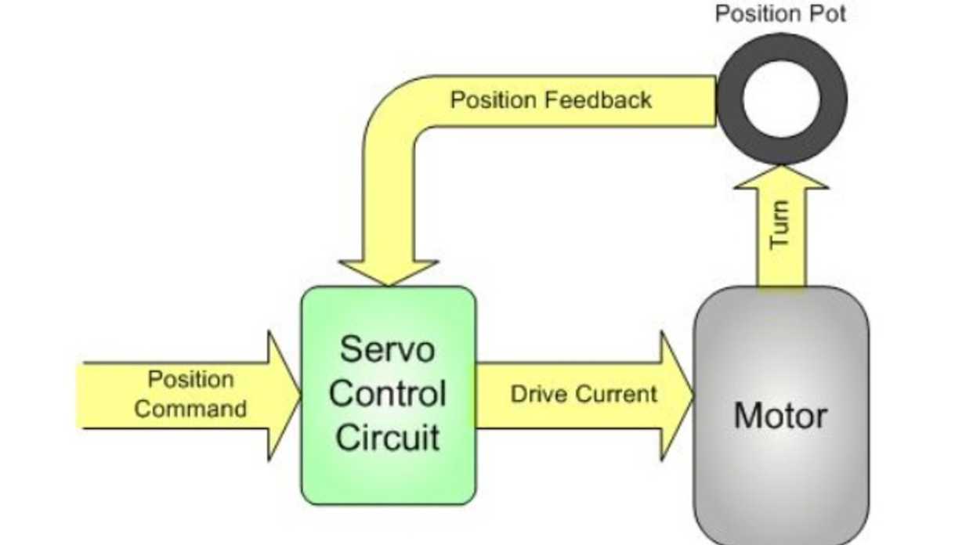
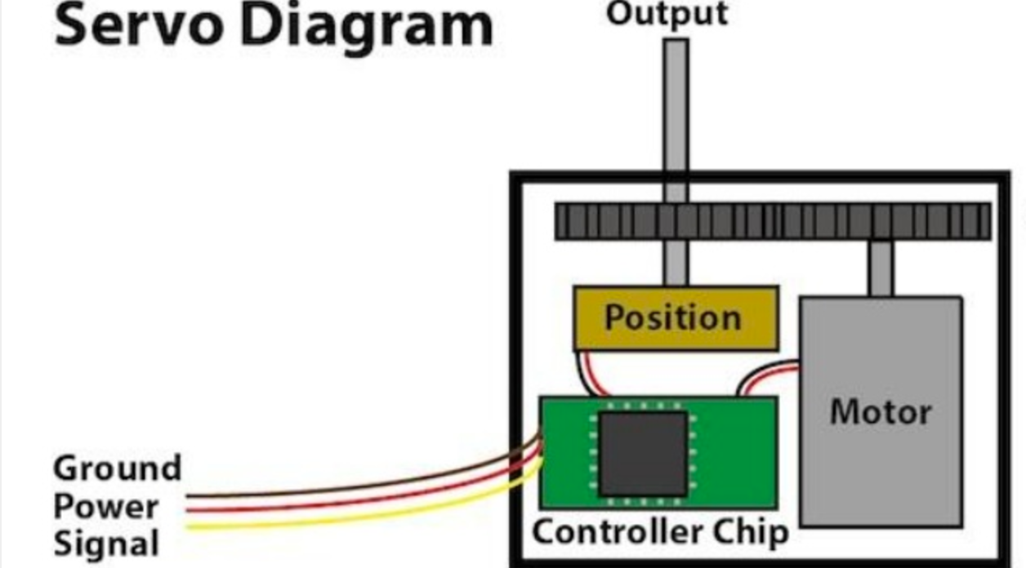
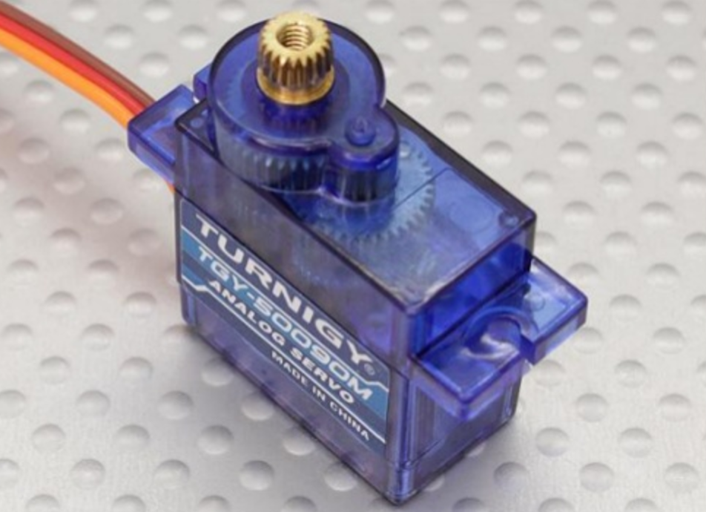
Servo Motor
A servo is a type of motor whose output shaft goes to a desired angular position and stays there.
It does this via a feedback loop comprising a position sensor, a control circuit, and a regular dc motor

Slide 7
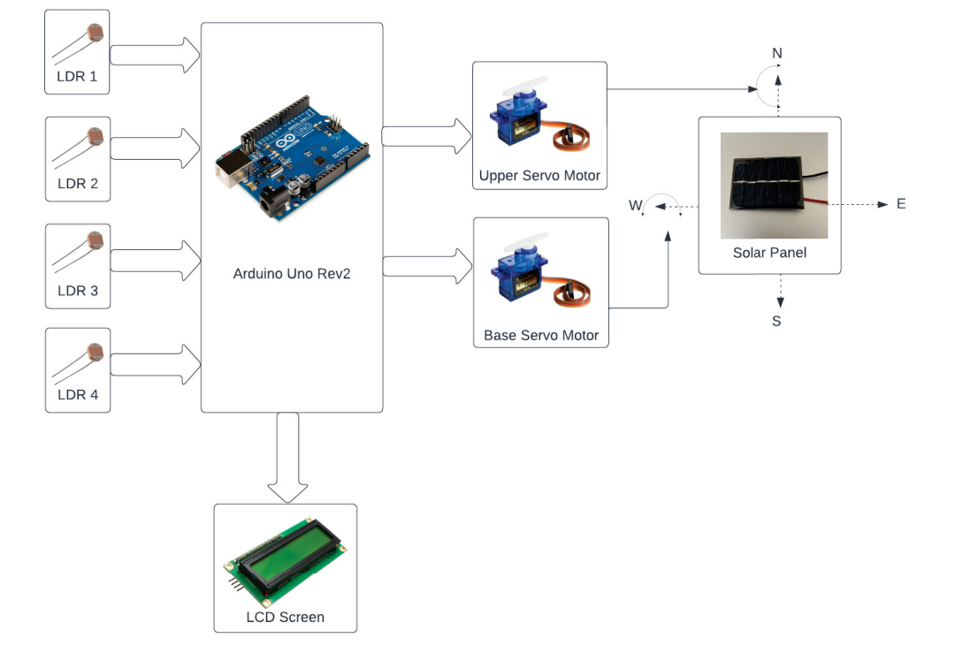
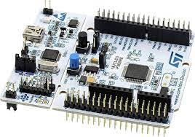
STM32 microcontroller
Block Diagram

Slide 8
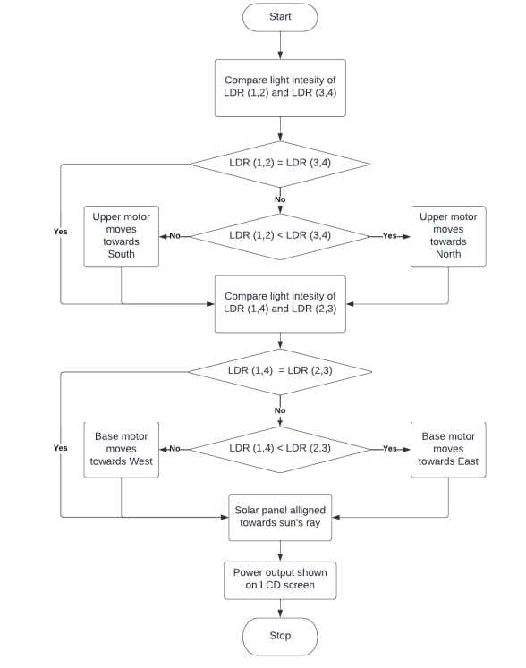
Implementation Flowchart

Slide 9
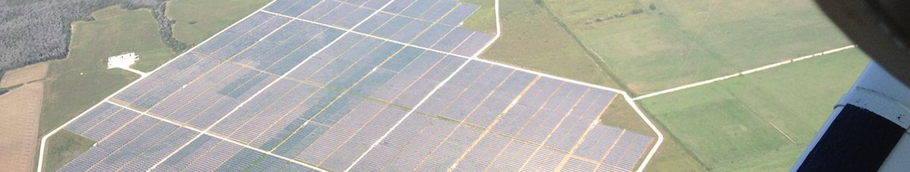
Advantages of Using a Dual Axis Solar Tracking System
1
Maximized Energy Production
2
Improved Efficiency
Continuous orientation toward the sun results in up to 25% more energy output.
Optimal positioning ensures higher overall system efficiency.

Slide 10
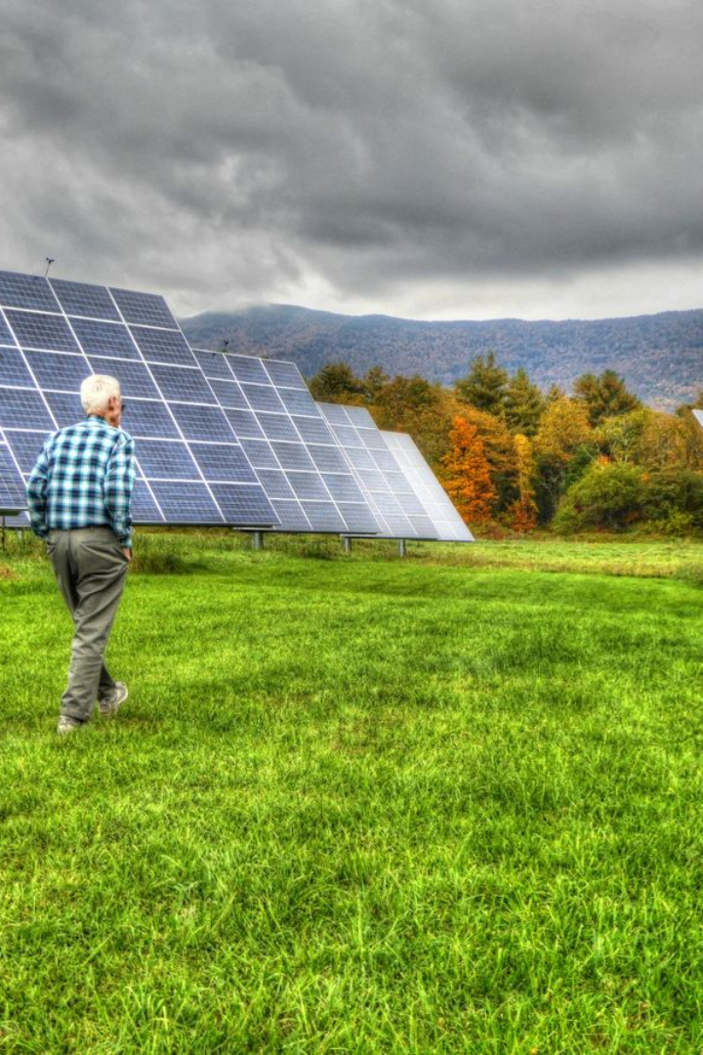
Calculating Daily Power Production for Each kW of Solar Panels
Solar energy, harnessed through photovoltaic (PV) panels, is a sustainable and eco-friendly way to generate electricity. Understanding the intricacies of calculating daily power production is essential for assessing the effectiveness of a solar panel system.

Slide 11
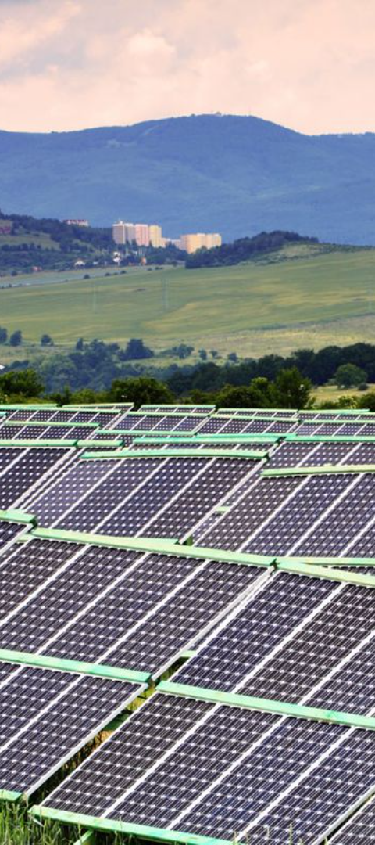
Understanding Solar Panels
1
Photovoltaic Effect
2
Electric Current Generation
Solar cells convert sunlight into electricity through the photovoltaic effect.
Dislodged electrons create an electric current, which is harnessed to produce electricity.

Slide 12
Factors That Affect Solar Panel Efficiency
Angle and Orientation
Temperature and Dust
Quality of Solar Panels
Proper alignment with the sun’s path ensures maximum exposure to sunlight.
Solar panels are more efficient at cooler temperatures.
High-quality panels tend to be more efficient.
Shading significantly impacts panel efficiency by blocking sunlight.
Accumulated dust and debris can hinder efficiency by blocking sunlight.

Slide 13
Solar Panel Efficiency and Standard Test Conditions
Standard Test Conditions (STC)
Conditions include a constant light intensity of 1,000 watts per square meter, a solar cell temperature of 25 degrees Celsius, and an air mass of 1.5.
Comparison and Evaluation
STC allows for the comparison of different solar panels under uniform conditions, facilitating efficient evaluation.

Slide 14
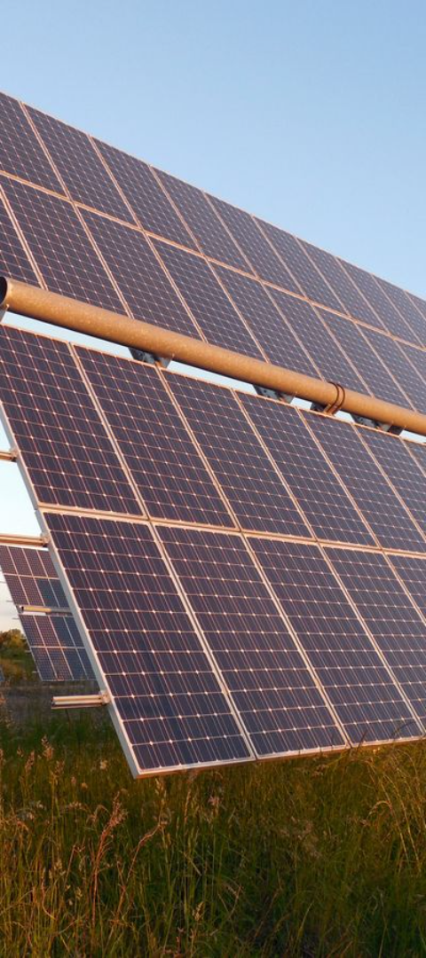
Solar Panels Generate Power According to Peak Sun Hours
1
Peak Sun Hours
2
Regional Variation
Peak sun hours represent the amount of sunlight that can be converted into electricity.
Different regions have varying numbers of peak sun hours based on climate and geographical location.

Slide 15
Calculating Daily Power Production: Step by Step
1
2
Determine the Amount of Sunlight
Consider the Efficiency
3
4
Calculate Peak Sun Hours
Calculate Daily Power Production

Slide 16

Factors Affecting Accuracy
Weather Variability
Dust and Debris
Weather conditions can impact the actual amount of sunlight received by the panels.
Accumulation can reduce efficiency by blocking sunlight.
Shading and Temperature
Shading and high temperatures can reduce solar panel efficiency.

Slide 17
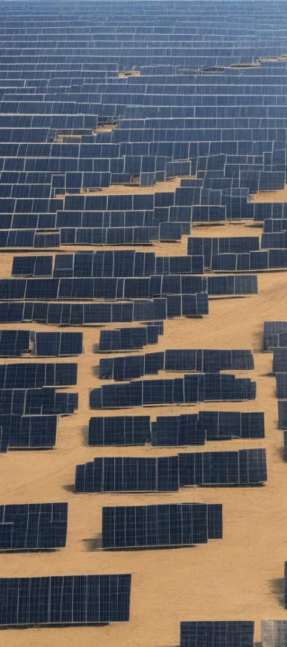


Conclusion: Harnessing Solar Energy
Estimating Power Production
Consider solar panel efficiency, peak sun hours, and number of sunlight hours.
Renewable Energy Source
Solar energy is a sustainable and renewable source of power.

